Slide 1
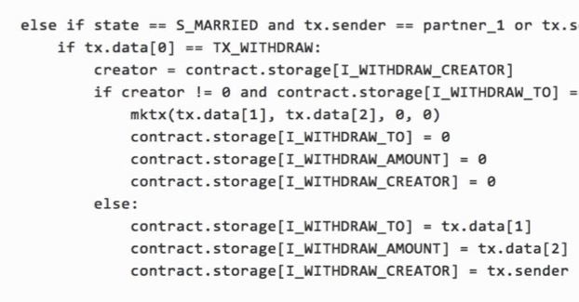

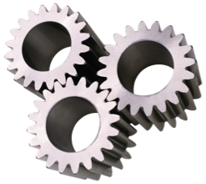
Town Crier:
An Authenticated Data Feed
for Smart Contracts
Fan Zhang
http://FanZhang.me
Ph.D. Student
Cornell, IC3
Santa Clara
13 August 2017
Notes:
I'm going to talk today about cryptocurrencies, the technologies that have been inspired by and built upon them, and their two contrasting personalities.

Slide 2


Interesting smart contracts need trustworthy data
Smart Contract Challenge #1:
Authenticated-Data Availability
Smart Contract
Webpage
contents
Stock quotes
Commodity
prices
Current
events
Weather
data
Sports
results
Notes:
Smart contracts are one of the most exciting developments in blockchain technology. But it’s also faced with a grand challenge, which is the lack of authenticated data.
If it's a financial instrument it needs access to equity prices. [Animation] Other smart contracts may need commodity prices, webpage contents, etc.
Smart contracts are data-hungry blockchain objects and today there's a lack of good ways to feed them.

Slide 3

Because blockchains are self-contained
Blockchain
Smart Contract
Authenticity: of undisputed origin
Notes:
Data must come from user account!
So Authenticity becomes critical.
Proposed sources:
Prediction markets (e.g., Gnosis)
Oracles, e.g., Oraclize.it
Big data brokers serve data (e.g., TLS-N)

Slide 4

Authenticity from HTTPS: TLS-based proofs
Blockchain
Data’
Smart Contract
<Data, Proof>
<Data, Proof>
Prover
Verifier
Web Server
Notes:
One way to obtain authentic data is to construct proofs based on TLS.
There are two other proposals in parallel with TC

Slide 5
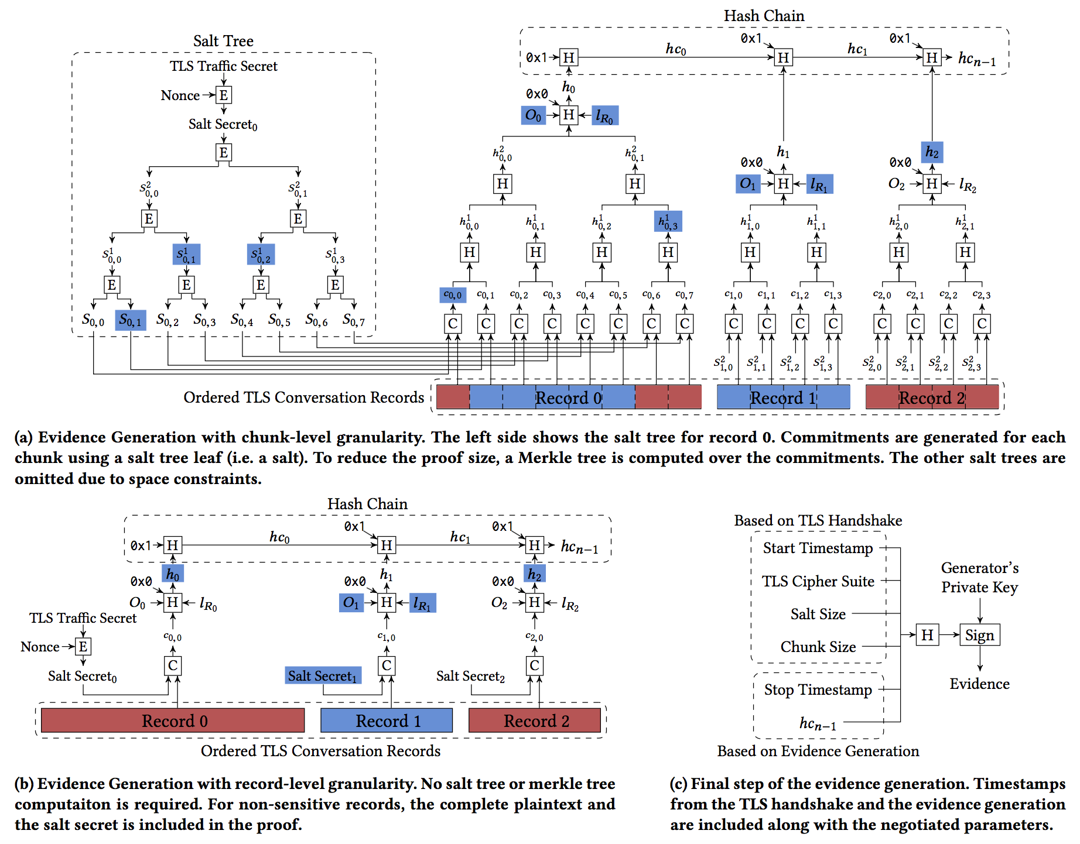
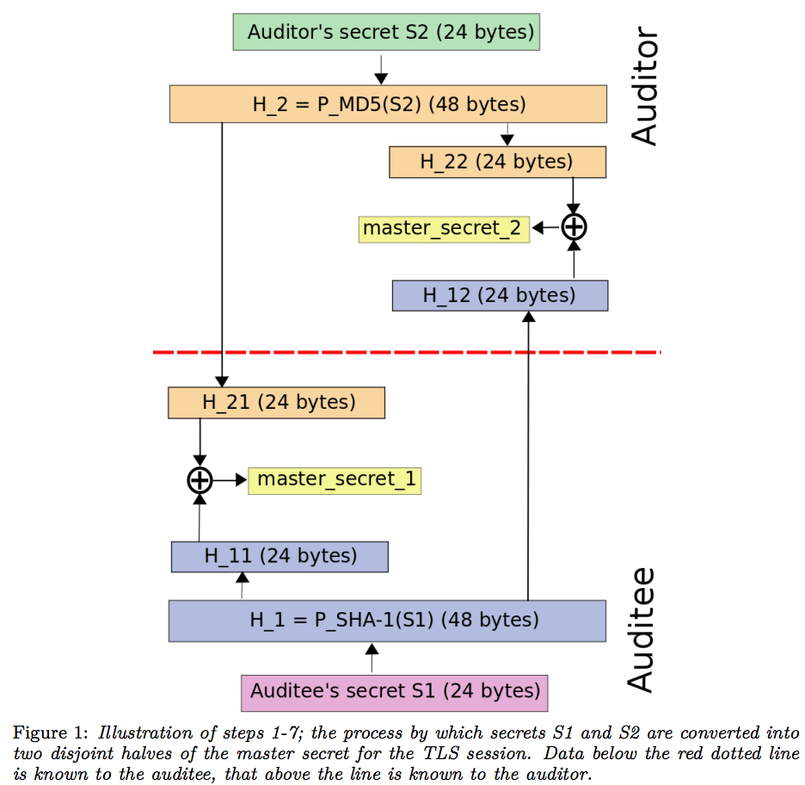
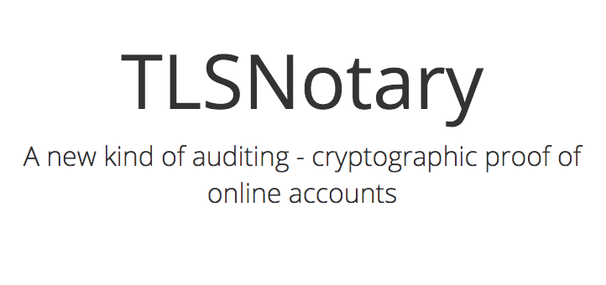
TLS-based Notarization
https://tlsnotary.org/
Modified keygen in TLSNotary
https://tls-n.org/

Slide 6
Related
 | Town Crier | TLSNotary | TLS-N
Root of Trust | Trust Hardware | Trusted Third Party (TTP) | Decentralized
Supported TLS Versions | Up to TLS 1.3 | <= TLS 1.1 Can only use MD5 and SHA-1 | Up to TLS 1.3
Ease of Adoption | Yes | Yes | Require modification to web servers
On chain digest cost | 0 | high | high

Slide 7
Related
 | Town Crier | TLSNotary | TLS-N
Root of Trust | Trusted Hardware | Trusted Third Party (TTP) | Decentralized
Supported TLS Versions | Up to TLS 1.3 | <= TLS 1.1 Can only use MD5 and SHA-1 | Up to TLS 1.3
Ease of Adoption | Yes | Yes | Require modification to web servers
On chain digest cost | 0 | high | high

Slide 8
Related
 | Town Crier | TLSNotary | TLS-N
Root of Trust | Trusted Hardware | Trusted Third Party (TTP) | Decentralized
Supported TLS Versions | Up to TLS 1.3 | <= TLS 1.1 Can only use MD5 and SHA-1 | Up to TLS 1.3
Ease of Adoption | Yes | Yes | Require modification to web servers
On chain digest cost | 0 | high | high

Slide 9
Related
 | Town Crier | TLSNotary | TLS-N
Root of Trust | Trusted Hardware | Trusted Third Party (TTP) | Decentralized
Supported TLS Versions | Up to TLS 1.3 | <= TLS 1.1 Can only use MD5 and SHA-1 | Up to TLS 1.3
Ease of Adoption | Yes | Yes | Require modification to web servers
On chain digest cost | 0 | high | high

Slide 10
Related
 | Town Crier | TLSNotary | TLS-N
Root of Trust | Trusted Hardware | Trusted Third Party (TTP) | Decentralized
Supported TLS Versions | Up to TLS 1.3 | <= TLS 1.1 Can only use MD5 and SHA-1 | Up to TLS 1.3
Ease of Adoption | Yes | Yes | Require modification to web servers
On chain digest cost | 0 | high | high

Slide 11

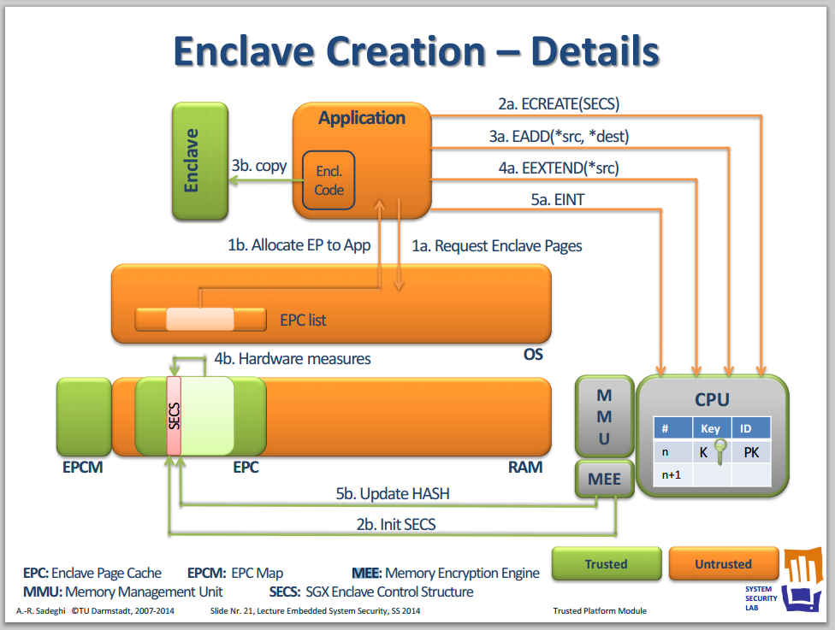
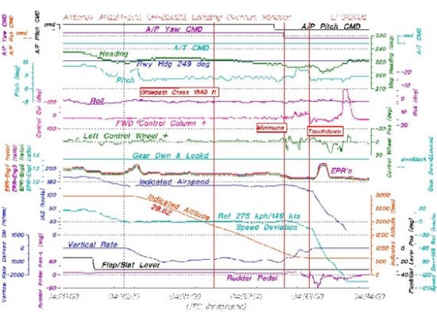
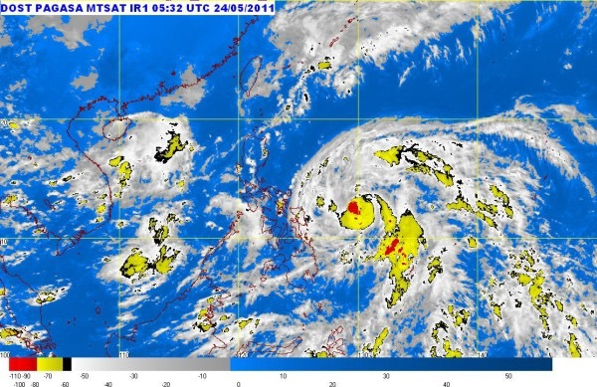
Town Crier
Fan Zhang, Kyle Croman, Ethan Cecchetti, Elaine Shi, and Ari Juels. Town Crier: An Authenticated Data Feed for Smart Contracts. ACM CCS 2016.

Slide 12

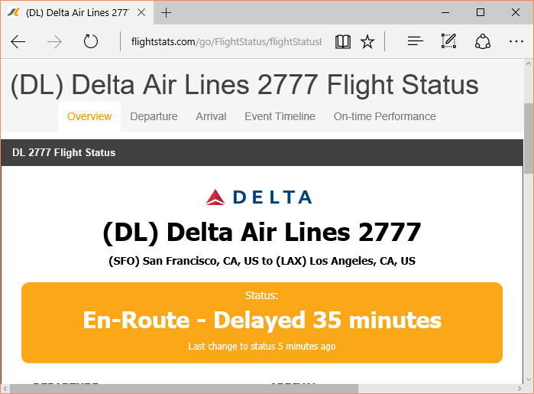
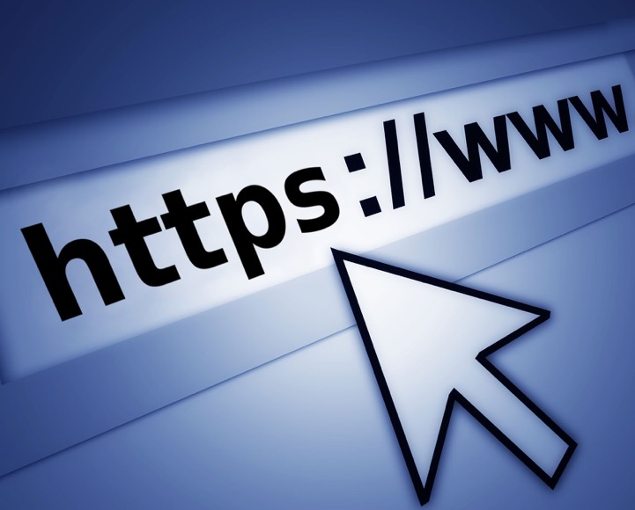


Town Crier (TC): Basic Idea
Blockchain
Trusted Website XYZ.com
Is DL 2777 delayed?
Flight
Insurance
Town
Crier
Delayed!
Authenticity property: Data delivered by TC is exactly as served on source site XYZ.com

Slide 13
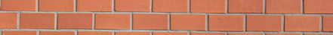



How to ensure authenticity?
Blockchain
Trusted Website XYZ.com
Flight
Insurance
Town
Crier
SGX

Slide 14






Software Guard eXtension
Integrity
“Enclave”
Confidentiality
Code & Data
Untrusted Application Code
Untrusted Operating System & Hypervisor
Other software and even OS cannot tamper with control flow.
Trusted
Processor
Untrusted Hardware
Other sofware and even OS can learn nothing about the interal state*.
* Provisos to be discussed

Slide 15





SGX: remote attestation
Report back your status.
Code & Data
Flight
Insurance
Untrusted Application Code
Attestation:
fingerprint
user data
signature
No longer need to to trust OS
Higher-level of security
Greatly reduces TCB
Untrusted Operating System & Hypervisor
Trusted
Processor
Untrusted Hardware
Remote entity
What makes SGX strong?

Slide 16
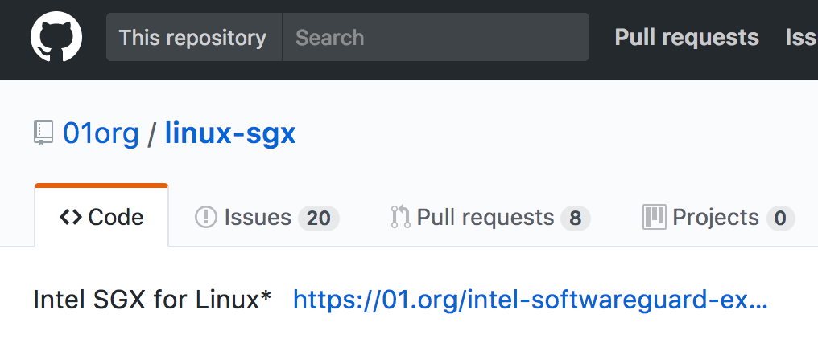
Trust Intel for…
securely and correctly manufacture SGX CPUs
Don’t rely on Intel for daily operation
Pros & Cons?
Greatly reduced software TCB
Widely available (Skylake, Kabylake CPU)
Trusting Intel?
https://github.com/01org/linux-sgx/
Notes:
- This is not specific to SGX. don’t know about you, but all of my laptops, desktops have Intel CPU.

Slide 17


Highlight of technical details
Blockchain
Trusted Website
Smart Contract
HTTPS
(PK_{TC}, SK_{TC})
Enclave
More details in
http://town-crier.org
and our paper!
HTTPS terminates in Enclave
Secure key generation in Enclave
Provable security in UC (Universal Composability)
Notes:
Without dwelling too much on technical details, I’d like provide you a highlight of TC system.
In a nutshell, two capabilities enabled by SGX form the foundation
HTTPS terminates in Enclave
Secure keys are generated within the Enclave (nobody sees it)

Slide 18
Town Crier Design Principles
Minimize TCB
Formal analysis / Proof
Transparent
No “obvious” security (esp. composing subsystems)
Rigorous proof in UC
Tripartite TCB
Be clear about assumptions & guarantees
Notes:
Before we dive into technical discussion, I’d like to highlight the design principles we followed while developing TC so that you could have a better understanding. We believe these principles are also applicable to other systems where security is a priority.
First, we design the system with the goal of minimizing TCB in mind. SGX and blockchain have different chars. We took advantage of both and combine them strategically to reduce the code in SGX enclave.
Second, we strongly believe that we can only claim security if we can prove it. Formal proof is not only necessary but also constructive. Because conducting proof exposes security vulnerabilities. That’s why we performed a rigorous modeling and proof. This is only possible if the system is well designed.
Third, we are totally transparent about the trust assumptions and guarantees. We also open source the entire code base for people to inspect at will. This actually is made possible by the proof we had, because otherwise even the builder of the system can not be sure about the security guarantees.

Slide 19
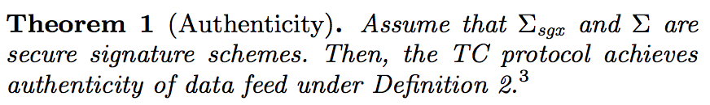
Security of TC
Adversary controls the host OS and the network
Assumption: SGX + TC code (publicly verified)
Town Crier
Untrusted Application Code
Untrusted Operating System & Hypervisor
SGX
Untrusted Hardware
Notes:
Relying contract sends query Q to TC
Goal: TC returns correct answer A to query Q
Another way to look at this is that the adversary controls the network, which includes everything outside the enclave and two other components

Slide 20


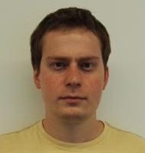

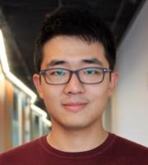
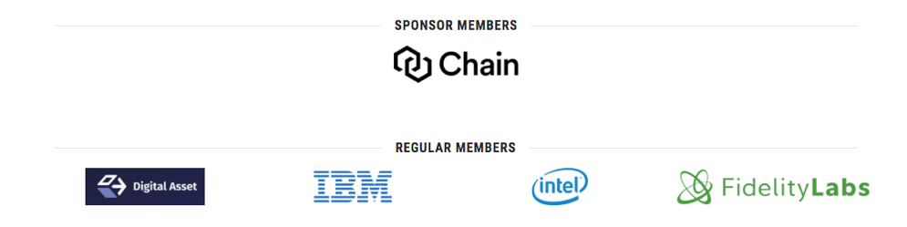
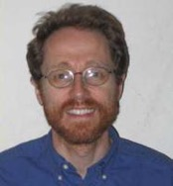
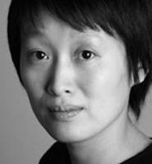
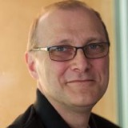
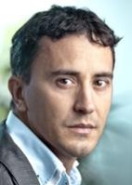
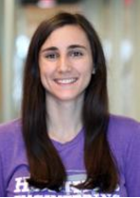
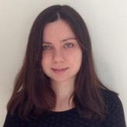
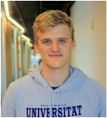

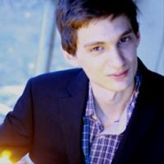
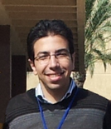
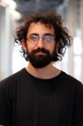



To learn more
Visit www.initc3.org and town-crier.org

Slide 21
More than an oracle:
Confidentiality
Blockchain
Smart contract
How to provide confidentiality for data processed by a smart contract with no confidential state?

Slide 22

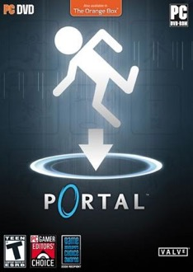




Versatility of TC: sell a digital game for ETH
Online game license
Ether
Steam Marketplace

Slide 23





Smart contract for sales of a game
Blockchain
Steam Trader
Steam Marketplace

Slide 24




Problems
Blockchain
SteamTrader needs to verify delivery
By logging in to Alice’s account
Using Alice's credential…
Steam Trader

Slide 25

Blockchain
Steam Trader
TC enables general smart contracts for digitally represented goods
($, cryptocurrency, online accounts, etc.)
4) Delivered?
1) E_{PK}[🔑]
3) Delivered?
🔑
2) secure login
using 🔑
Town Crier
secret
guarded by SGX
http://store.steampowered.com/

Slide 26

Yet another problem: What if node or source is compromised?
✘
Town
Crier
✔︎

Slide 27

We can have
redundant sources
On chain cost is reduced.
✔︎
Town
Crier
✔︎
✔︎
Majority vote!
✘

Slide 28
+ redundant nodes
Majority vote!
Town
Crier
Contract
Majority vote!
Majority vote!
Town
Crier
Majority vote!
Town
Crier

Slide 29
TC summary
Bridge from HTTPS websites to blockchains
Addresses key impediments to smart contract adoption:
Provides authenticity property
Provides confidentiality
Now available on Ethereum mainnet!

Slide 30
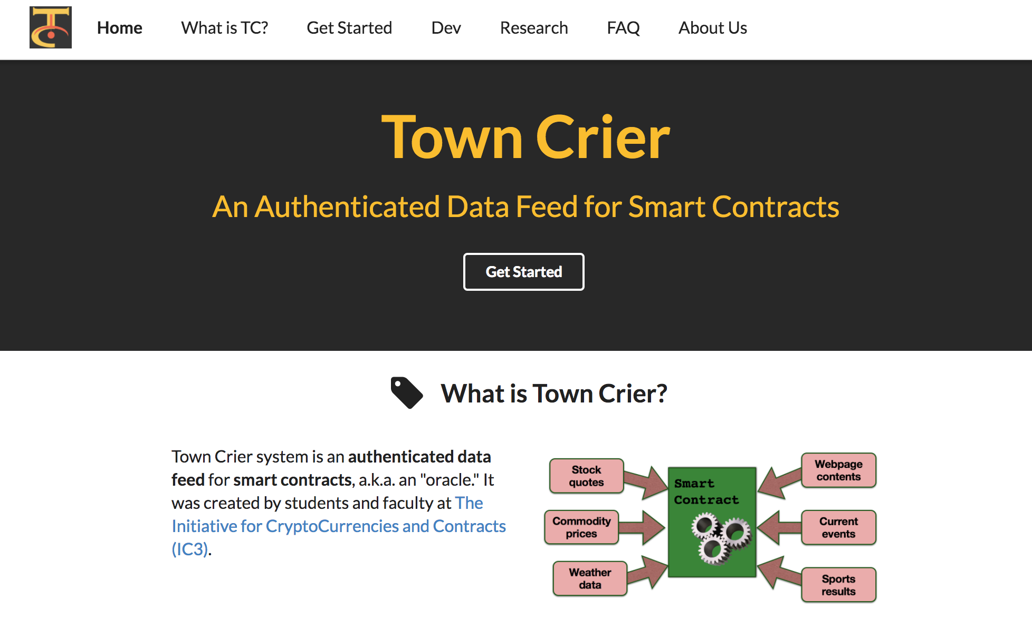
www.town-crier.org

Slide 31
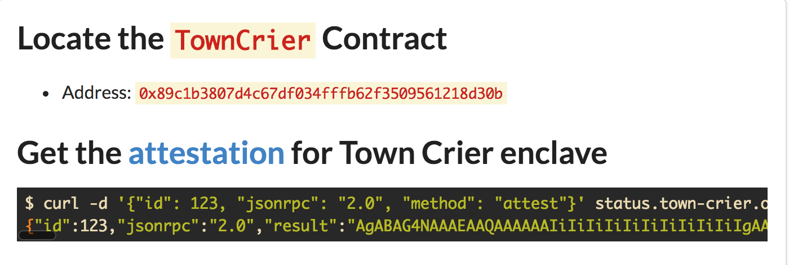
Basics

Slide 32
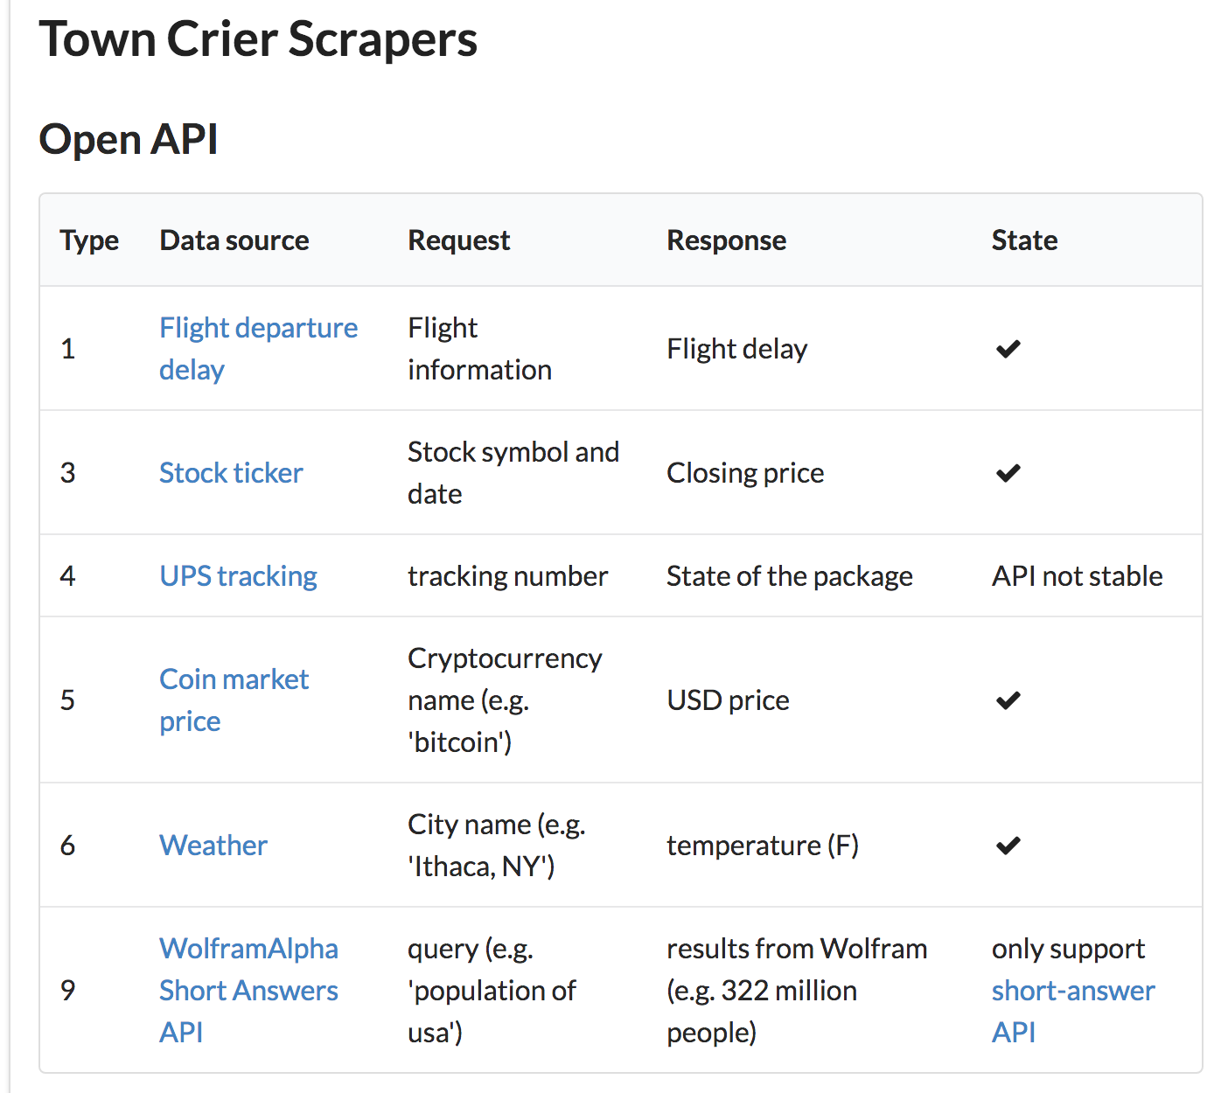
Feeds / scrapers

Slide 33
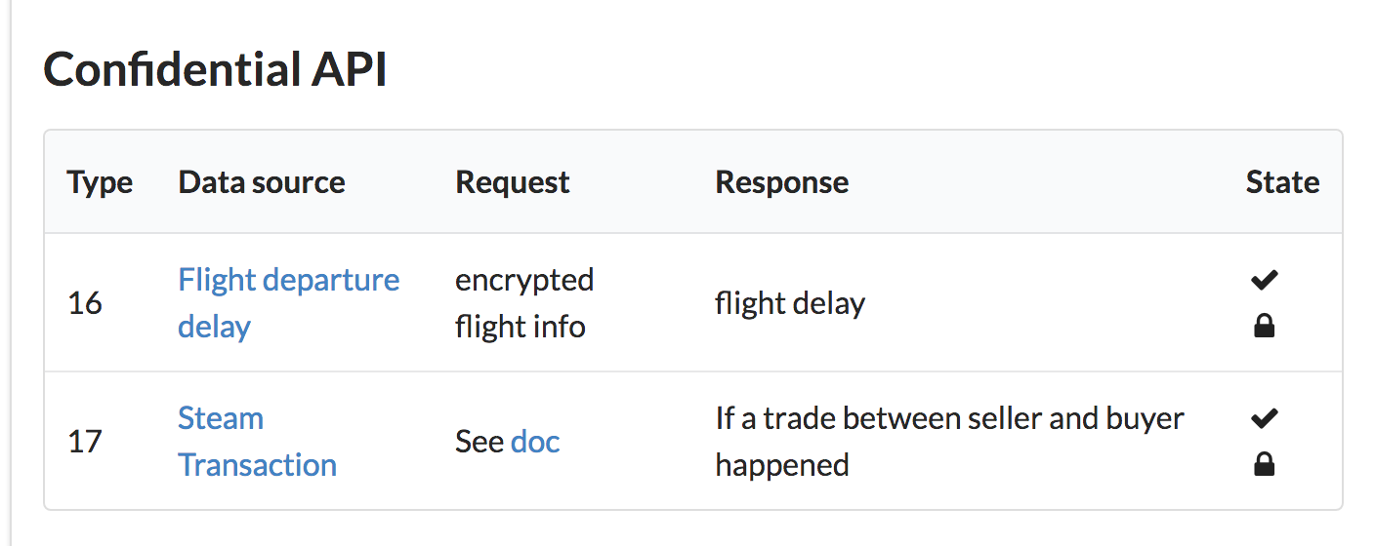
Feeds / scrapers

Slide 34








Tripartite TCB
Smart contract
Trustworthy execution
No confidentiality
Expensive computation
TC enclave
Trustworthy execution
Cheap computation
No network stack
Trusted website
Source authentication
No digital signatures on content
Blockchain
Flight
Insurance
TC
Contract
Town
Crier
SGX
Notes:
The reason for this tripartite TCB is such a design allows us to shrink the size of TCB without losing any security guarantee.

Slide 35







TC goal / adversarial model
Goal: TC returns correct answer A to query Q
Assumption: SGX + TC code (publicly verified)
Adversary controls TC node OS and the network
Simpler view: network adversary outside enclave
Blockchain
Trusted Website XYZ.com
Flight
Insurance
Q
Town
Crier
A
SGX
Notes:
Relying contract sends query Q to TC
Goal: TC returns correct answer A to query Q
Another way to look at this is that the adversary controls the network, which includes everything outside the enclave and two other components

Slide 36







TC goal / adversarial model
Adversary controls
network outside enclave
Blockchain
Town
Crier
Flight
Insurance
Trusted Website XYZ.com
Notes:
Town Crier is adrift in this adversarial sea

Slide 37
Blockchain
Trusted Website XYZ.com
Flight
Insurance
Town
Crier
SGX
TC code is published
TC instance created with public key PKTC to sign data

Slide 38
Blockchain
Trusted Website XYZ.com
Flight
Insurance
Town
Crier
SGX
Isn’t checking expensive?🤔
TC generates (PK,SK) and publishes PK
Flight Insurance: checks signature using PK
Free!
- Sign Tx with SK.

Slide 39
Actually, a little more complicated…
Blockchain
Flight
Insurance
TC
Contract
TC
Account
Town
Crier
PKTC
SGX

Slide 40
Blockchain
Trusted Website XYZ.com
Flight
Insurance
Town
Crier
SGX

Slide 41

Blockchain
TC Contract
Flight
Insurance
A'
A'
Town
Crier
Q'
Q
Problem: Q' may be corrupted Q—or altogether fake!
Could run blockchain client (Ethereum) in enclave
Could verify Q from blockchain
But would bloat TCB!

Slide 42
Blockchain
TC Contract
Flight
Insurance
A'
A'
,Q'
Q'
Town
Crier
Q'
Q
Our approach: Leverage hybrid trust model
Potentially corrupted query Q' processed by TC
TC digitally signs (A', Q') using SKTC
TC contract verifies Q = Q'

Slide 43
Another problem:
Gas depletion
Recall: Ethereum uses currency called "gas"
Prevents DoS
Charges fairly for computation costs
Blockchain
Smart Contract
Smart Contract'
TC
Account
msg,
$gas
msg'
$gas'

Slide 44
Another problem:
Gas depletion
TC service needs to initiate call to return data A
TC must pay gas cost for this return call… yet avoid malicious gas-depletion calls from other contracts
Blockchain
Flight
Insurance
TC
Contract
Town
Crier
SGX

Slide 45




Gas sustainability
Fundamental and general availability property for compound smart contracts
Informally: service never runs out of gas
Formal definition in paper
TC requires up-front deposit of gas (ether) from relying contract
Formal proof of gas sustainability for TC in paper
Blockchain
TC
Contract
Flight
Insurance
Town
Crier
SGX

Slide 46

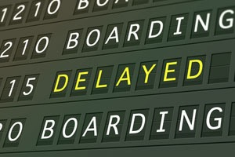

Running example:
Self-enforcing insurance policy
Gimme a $100 policy
(Flight #1215, 17 May,
Policy price: $1)
Flight
Insurance
$100

Slide 47






Idea: Leverage enclave confidentiality
Flight delayed /
not delayed
Blockchain
EPK_TC[flight info]
Flight
Insurance
TC
Contract
Town
Crier
$$$
SGX
Additional steps needed
E.g., delay response / payment to noise timing side-channel

